Slide 1
SV Based Semi Fragile Watermarking for Image content Authentication
By,
Sneh Shrivastava

Slide 2
Introduction
Fragile watermarking techniques aim to be fragile to any modifications so as to detect and localize these modifications. Semi-fragile watermarking techniques aim to resist acceptable content-preserving modifications and detect malicious content-altering modifications. Self-recovering watermarking techniques incorporate the content recovery property in either fragile or semi-fragile schemes to not only detect and localize the modifications but also recover the original content. However, self-recovering fragile techniques work well when the tampered area is not extensive and self-recovering semi-fragile techniques work well under mild or no content-preserving modifications.

Slide 3
Semi-fragile watermarking algorithms can be classified into spatial domain-based and transform domain-based schemes. In general, spatial domain-based schemes embed watermark into the host image by modifying a set of pixel values without causing obvious changes in its appearance. Transform domain-based schemes embed watermark into the host image by modifying transformed coefficients such as discrete cosine transform (DCT) coefficients and discrete wavelet transform (DWT) coefficients. Both schemes use extracted watermark to authenticate the digital content and localize tampered areas if possible. Transform domain-based schemes are better than spatial domain-based schemes since they tend to achieve better invisibility and more robustness.

Slide 4
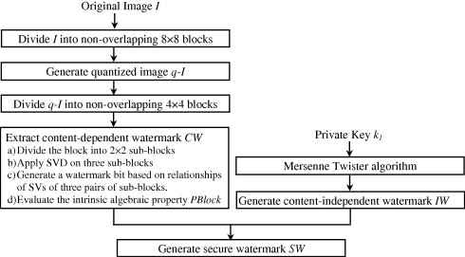
Secure Watermark Generation

Slide 5
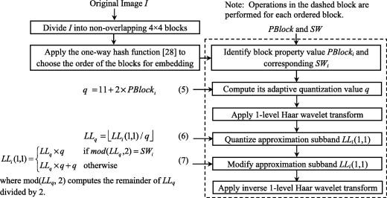
Watermark Embedding

Slide 6
Watermark Extraction
The watermark extraction process is similar to the watermark embedding process except that it uses the parity of the quantized upper-left value of the approximation subband of each non-overlapping 4 4 block to extract the watermark bit. The upper-left value LL(1, 1)⁰ of each block is quantized by the adaptive quantizer q calculated by as follows:
LL0 = round(LL(1,1)’/q)
The watermarked bit EW_{i} for each block is extracted as mod(LL_{q}⁰, 2).

Slide 7
Watermark Authentication
First Stage
M1= No. of error pixels in ErrorMap/No of pixels in error map
M2= No. of strongly tempred error pixels in Error Map/No of tampred error pixel in error map
M₁ measures the similarity between extracted and regener-ated secure watermarks and M₂ measures the clustering level of tampered error pixels. M₂ is set to 0’s if the count of tampered error pixels is zero.

Slide 8
2nd Stage
M3=No of error pixels in STErrorMap/No of connected components in STErrorMap
M4=std(size of all the connected components
M₃ measures the average size of connected components and M₄ measures the size variation of all connected components. This authentication process aims to distinguish between tampered regions caused by content-altering modifications and tampered regions caused by moderate content-preserving modifications.

Slide 9
3rd Stage
M5=No of error pixels in processed STErrorMap/No of error pixels in processes STErrorMap and MTErrorMap
This authentication process aims to identify tampered regions when the probe image undergoes content-altering modifications together with moderate to severe content-preserving modifications.

Slide 10
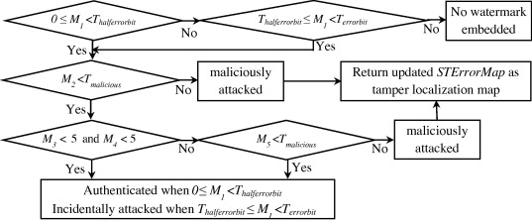
Flowchart for computing 5 authentication measures

